Slide 1
SYMMETRIC AUTHENTICATION
DR. O. I. ADELAIYE

Slide 2
AUTHENTICATION
Is a user the person they pretend to be?
Entails data integrity
Does not make sense to be sure about the origin of the message if the message was modified en route !
Comes before confidentiality and data integrity
Authorization depends upon authentication
Three types of authentication
Something I am
Something I know
Something I posses

Slide 3
HIGHLIGHTS
“Something I possess” based authentication
“Something I am” based authentication
“Something I know” based authentication
Password-based Authentication
Kerberos
Diffie-Hellman

Slide 4
SOMETHING I POSSESS

Slide 5
SOMETHING I POSSESS????
Physical
Proximity card
Smartcard
Visa card
Private key
Passport
Mobile phone
Attacks are “easy” to detect

Slide 6
SOMETHING I POSSESS????
These are usually two factor authentication systems, and rely on something you possess and something you know
e.g. mobile phones-based authentication

Slide 7
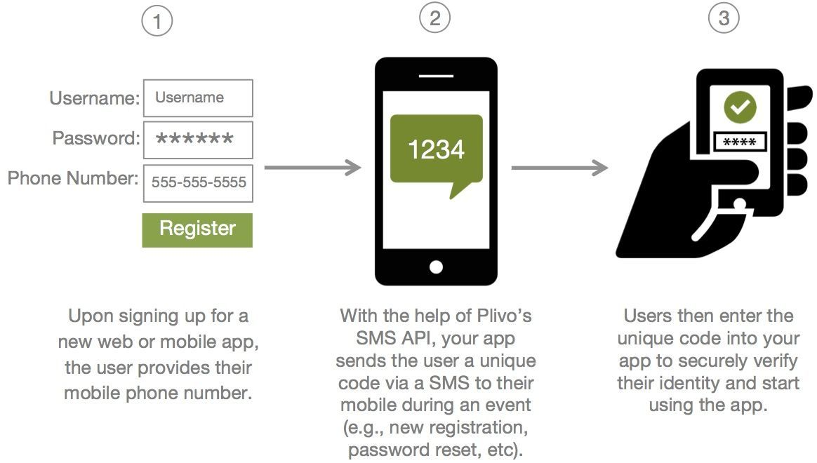
AUTHENTICATION USING MOBILE PHONES
Source: www.pilvo.com

Slide 8
SOMETHING I AM

Slide 9

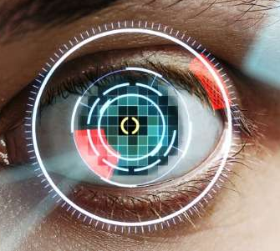
SOMETHING I AM???
Fingerprint
DNA testing
Retina Scans
Potentially the strongest type of authentication

Slide 10
SOMETHING I AM???
But many problems with them today
The comparison is an approximate match against a template and this produces False Positives and False Negatives
The biometric needs to be captured live since they are not secret and can be copied/stolen e.g. a fingerprint from a glass or a hair from clothing

Slide 11
SOMETHING I KNOW

Slide 12
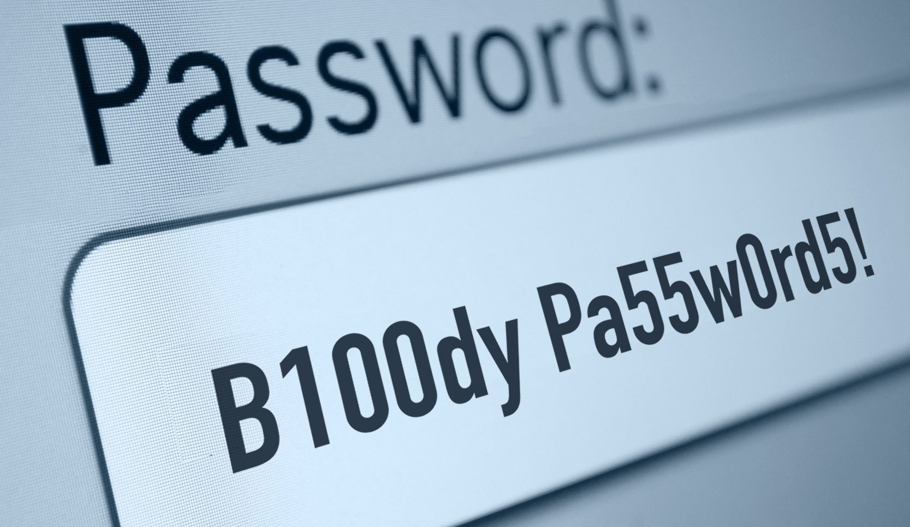
SOMETHING I KNOW???
A password
A secret that is used for authentication
A cryptographic secret
A secret that is combined with cryptographic algorithms
Usually the weakest type of authentication
Secret might be copied without being detected
But the most common type
today

Slide 13
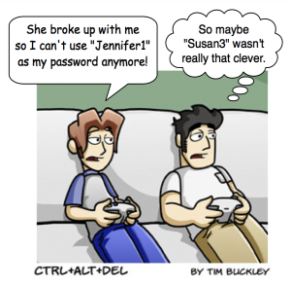
BREAKING PASSWORDS

Slide 14
BREAKING PASSWORDS
The attacker uses knowledge about the user many users have passwords that are personal to them.
Name of husband, wife, daughter, son.
Name of family pet.
Name of the street or town where they live or where they were born.
Their house number, telephone number, car reg.

Slide 15

REALITY
The attacker uses a dictionary a large percentage of passwords may be normal words.
More chance that a user will have a password that is easy to remember than a random string.
Attacker tries words from a dictionary.
Could have millions of words

Slide 16
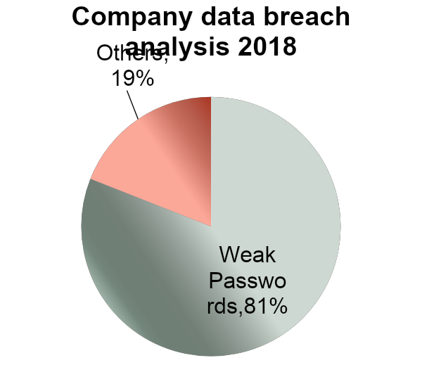
BREAKING PASSWORDS
Top 25 passwords
123456 (Up 1)
password (Down 1)
12345678 (Unchanged)
qwerty (Up 1)
abc123 (Down 1)
123456789 (New)
111111 (Up 2)
1234567 (Up 5)
iloveyou (Up 2)
adobe123 (New)
123123 (Up 5)
Admin (New)
1234567890 (New)
letmein (Down 7)
photoshop (New)

Slide 17
PASSWORD ATTACKS
Attack using brute force: try all combinations!
Serious problem if users have short passwords
If we use only the letters a-z in lower case then:
Usually recommend 8 or more characters, mixed letters and numbers.
Far slower than dictionary attack
Longer keys are more difficult to attack
Letters a-z | Combinations
1 | 26
2 | 676
3 | 17576
4 | 456976
5 | 11881376
6 | 308915776

Slide 18
Key Size (bits) | Number of alternative keys | Average time required at one decryption per microsecond
40 | 1.1 * 10¹² | 6.36 days
56 | 7.2 * 10¹⁶ | 1142 years
128 | 3.4 * 10³⁸ | 5.4 * 10²⁴ years
256 | 1.1 * 10⁷⁷ | 1.7 * 10⁶³ years
For comparison, the universe has been in existence less than 2x1010 years

Slide 19
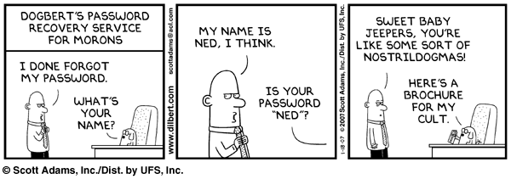
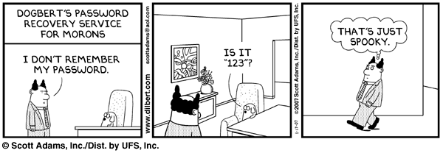
CHOOSING GOOD PASSWORDS

Slide 20
CHOOSING GOOD PASSWORDS
Never make it a real word - too vulnerable to dictionary attacks and guessing
Always should be easy to remember and hard to guess
Should be a combination of UPPER and lower case, numerals, letters and punctuation
Should be reasonably long
6 characters is only equivalent to a 40bit symmetric key
Need about 22 random characters to be equivalent to 128 bit key

Slide 21
SUGGESTIONS!!!
Some suggestions
Use the first letters of a phrase e.g. use
TamfIbitw from “The answer my friend is blowing in the wind”
Join several short words together e.g. iLoveNY!
Make up nonsense phrases e.g. Fip&Chips

Slide 22
PROTECTION : LOGIN PROCESS
Make login process slow - e.g. add a 1 second delay between each login.
Keep a record of failed login attempts and temporarily disable a login if a small limit is exceeded (ATM machines)
Ask the user to carry out an action which requires human intervention
Recognising letters inside an image
Recognising a word in a sound file

Slide 23





PROTECTION : LOGIN PROCESS

Slide 24
SYMMETRIC AUTHENTICATION SCHEMES
Most authentication schemes are based on a shared secret, where both parties know the same secret e.g.
One time passwords
Password-based authentication,
Symmetric encryption based schemes: Kerberos

Slide 25
ONE TIME PASSWORD - SOFTWARE
“One time password” schemes use a shared secret (e.g. a password) and an encryption algorithm to produce an encrypted secret that is used just once as a one time password
S/Key from Bellcore - Internet RFC 1760
User’s password and seed are hashed multiple times using MD4 hashing algorithm

Slide 26
SOMETHING I KNOW
PASSWORD BASED AUTHENTICATION

Slide 27
PASSWORD BASED AUTHENTICATION
Based on usernames and passwords
Password may be passed
As a clear text
Or hashed (along with a “salt” word)
Or encrypted ( and salted)
Often open to sniffing attacks, dictionary attacks and pre-computed hash attacks
No Internet standards can now be based on clear passwords

Slide 28
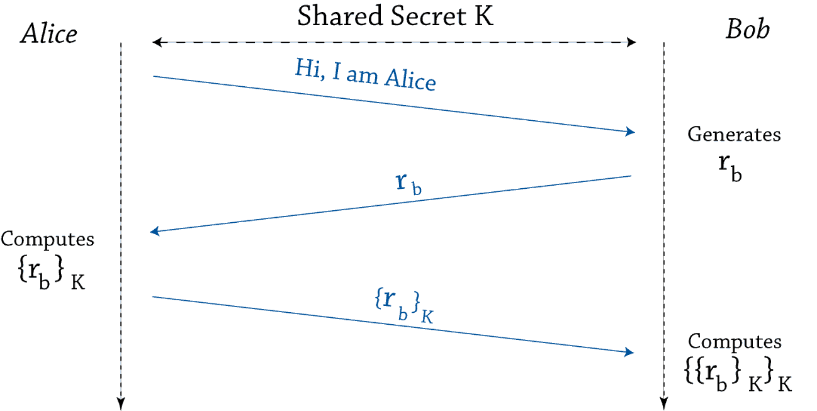
PASSWORD BASED AUTHENTICATION
Symmetric Cryptography
Strong authentication: Alice proves to Bob that she know a pre shared secret without revealing it (challenge/response)
If Alice wants to prove her identity to n users, she stores n shared secret
Q: Pick a new random each time, why?

Slide 29
DISTRIBUTED SYSTEMS AND PASSWORD AUTHENTICATION
How can I gain access to multiple computer systems if password based authentication is used? Possible solutions:
Multiple passwords, one for each system
Use same password in all systems?
Single sign-on application that stores the passwords for each system and has one for itself
E.g. Mozilla firefox
Single sign-on where password is stored in just one system and other systems trust this one to perform the authentication properly on their behalf (e.g. Microsoft Passport, Shibboleth)

Slide 30
THE MUTUAL AUTHENTICATION PROBLEM
How can two people authenticate to each other using passwords?
If a set of N persons mutually share symmetric secrets, the system will need N(N-1)/2 keys
Scalability issues

Slide 31
SOMETHING I KNOW
KERBEROS

Slide 32
NEEDHAM-SCHROEDER
Is based on encrypting a message with a shared secret, so that only the other party knowing the secret can decode the message.
But cannot share secrets with everyone – multiple password problem again. Therefore share with just one party – a secret key server.
Trusted symmetric key server shares a secret key with every user.
When Alice wants to talk to Ben she asks the key server for a new secret key.
The key server generates a new key, encrypts it with Alice’s secret and sends it to Alice. It also includes the new key encrypted with Ben’s secret.
Alice decrypts the message and forwards Ben’s encrypted key to him
Ben decrypts the new key and sends a confirmation message to Alice encrypted with the new key
Alice decrypts this, performs a simple operation on the message and sends it encrypted back to Ben
Both sides now know that they share the same secret

Slide 33
NEEDHAM-SCHROEDER
1. Alice->Server: A, B, Na.
2. Server->Alice: {Na, B, Kab, {Kab, A}Kbs}Kas
3. Alice->Ben: {Kab,A}Kbs
4. Ben->Alice: {Nb}Kab
5. Alice->Ben: {f(Nb)}Kab
Where A=name of Alice
B=name of Ben
Na=nonce generated by Alice
Nb=nonce generated by Ben
Kab=New secret key to be used by Alice and Ben
Kbs=Ben’s secret shared with the server
Kas= Alice’s secret shared with the server
F(Nb)= a simple function applied to Nb such as subtracting 1

Slide 34
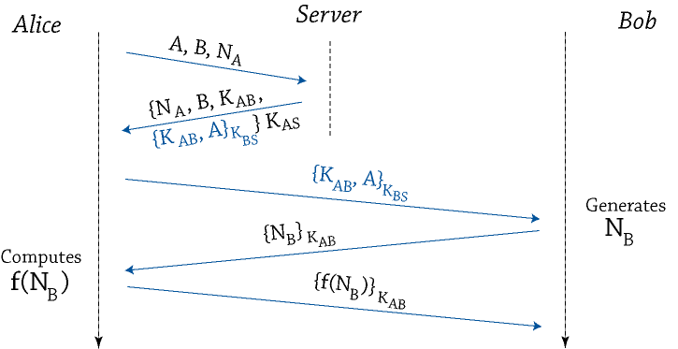
NEEDHAM-SCHROEDER

Slide 35
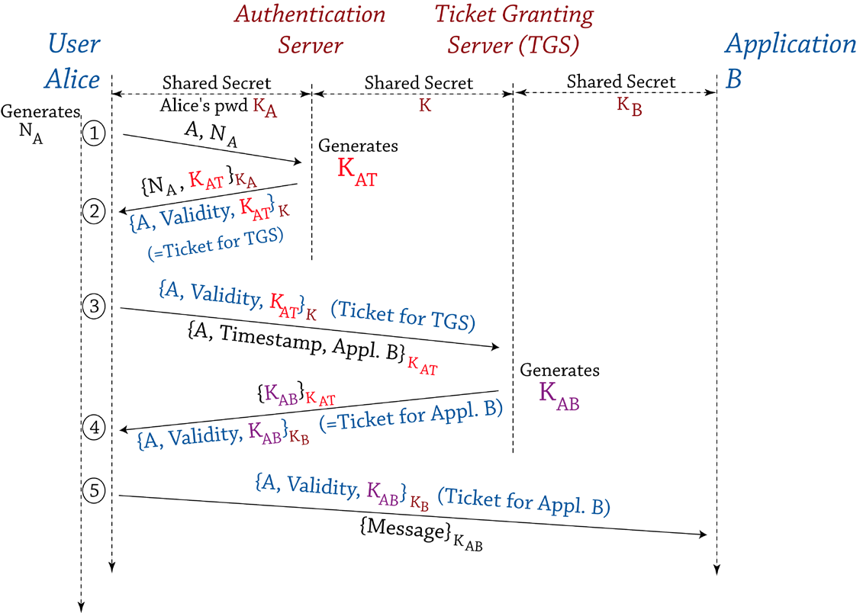
KERBEROS

Slide 36
SUMMARY OF PROBLEMS WITH SHARED SECRET/SYMMETRIC ENCRYPTION TECHNIQUES
They need a shared secret, and each pair of users needs a different shared secret
Secret key management – how to reliably share the secret without anyone else eavesdropping
Not easily scalable
Possible solutions:
Use a key server such as in N-S and Kerberos
Use a Key exchange protocol such as Diffie Hellman
Use asymmetric encryption

Slide 37
DIFFIE HELLMAN

Slide 38
DIFFIE HELLMAN KEY EXCHANGE PROTOCOL
Allows two people to calculate a shared secret, without eavesdroppers being able to work out the shared secret.
It works using complicated mathematics based on an exponential equation and modulus X=Y^{A} Mod P
A group of people agree on values for Y and P
If two people want to share a secret, they each choose different values for A (A₁ and A₂) and send the result of the calculation, X₁ and X₂ to each other.

Slide 39
DIFFIE HELLMAN KEY EXCHANGE PROTOCOL
They then perform the following
calculation S=X_{i}^{A} Mod P using their own A and the received X_{i} , and each derives the same secret S, which no-one else can do because no one else knows either A₁ or A₂
Proof. S=X₁^{A2} Mod P = X₂^{A1} Mod P = Y^{A1A2} Mod P

Slide 40
END

